Slide 1
Project Proposal
Data Statistics SS 2022
Supervisor: Dr. Dinkelacker
Tutor: Ian ?
TRAs expression in Human Embryo Cells
Alina Aksianova, Letizia Holube, Nina Bank, Lydia Steiner

Slide 2
TRAs
Tissue Restricted Antigenes
Central tolerance of the immune system = Negative Selection process (Kyewski & Klein,2006)
Developing T-Cells -> exposed to TRAs in thymus -> binding cells apoptosis
Defect: Auto immune diseases, e.g. Diabetes Type I (Atkinson, Eisenbarth, Michels, 2014)
Application: Tumor Marker, Immunotherapy (Hong, 2014), (Mahmoud,2018)

Slide 3
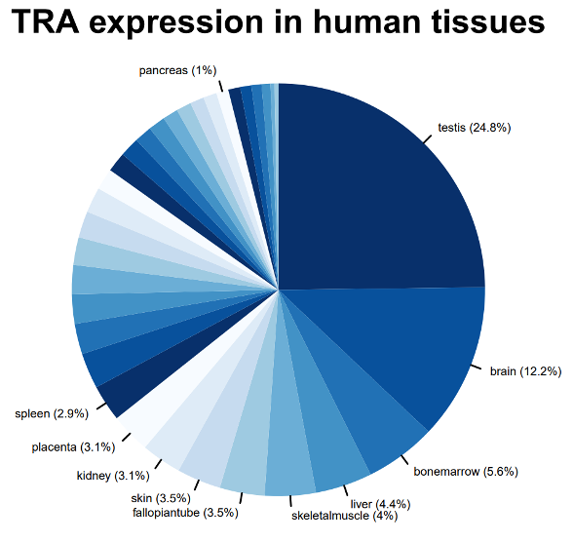
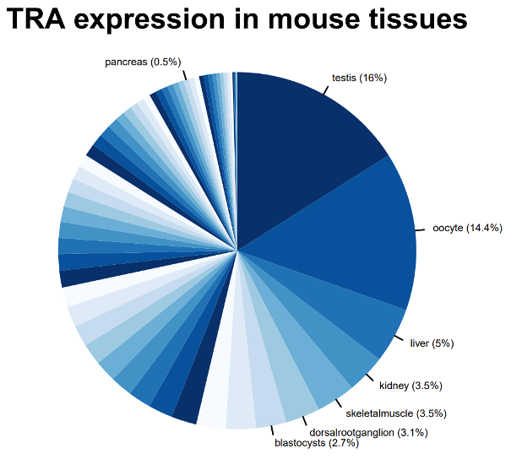
TRA-gene table
tra.2014.human.5x.table
ensembl.transcript | ensembl.gene | gene.symbol | entrezID | refseqID | unigeneID | chrom | startsite | tiss.number | tissues | max.tissue
ENST00000004103 | ENSG00000002933 | TMEM176A | 55365 | Hs.647116 | Hs.647116 | 7 | 150497491 | 2 | PB-CD14+Monocytes/Liver/kidney | Liver
Dinkelacker, 2007
Dinkelacker, 2019

Slide 4
Dataset
What did we choose, why did we choose it
Irie, N., & Kuratani, S. (2011). Comparative transcriptome analysis reveals vertebrate phylotypic period during organogenesis. Nature communications, 2, 248. https://doi.org/10.1038/ncomms1248
Gene Expression in mouse embryo development
Intervals: E7.5, E8.5, E9.5, E10.5, E12.5, E14.5, E16.5, E18.5 (days after mating)
each containig 2-3 samples with RNA of multiple whole embyos
Notes:
Phylotypic stage: developmental period in mid-embryogenesis where related species within a phylum (Tierstamm), highest resemblance

Slide 5
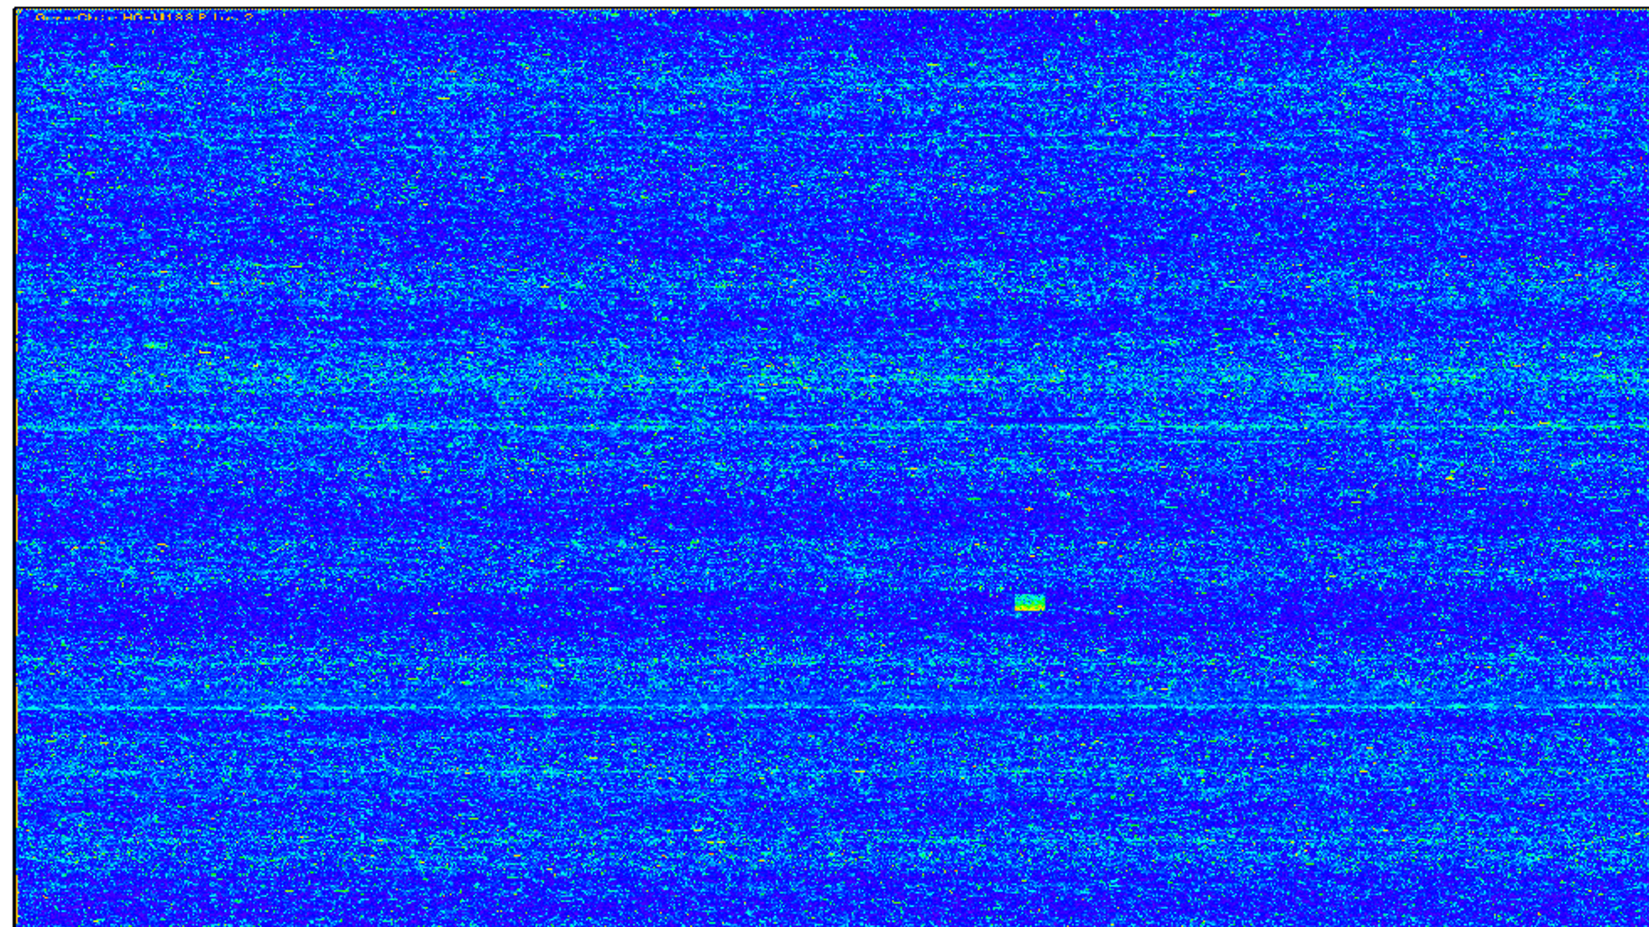
Microarrays
Gene Chip that reads gene expression in form of RNA
RNA -> cDNA -> labelling -> Hybridisation -> Scanning -> Data Acquisition
Labelling via biotin or Fluorescence
Brand of chip: Affymetrix Mouse Genome 430 2.0 Array
Internal Quality Control

Slide 6
Early organ development in mouse embryo

Slide 7
Methods
RNA degradation plot for quality control
VSNrma Normalisation
Boxplot before and after normalisation
If necessary Quantile normalisation
Scatter plot to control chip quality

Slide 8
Clean Data: Correctly assign gene names to Microarray dataset
New table with genes of low variance removed

Slide 9
Chipwise Quality Control
Maybe, we can try this out for a few chips and include some examples
Single cell control

Slide 11
Timeline
Week 1
Week 2-3
Week 4-6
Week 7-8
13.07. 2022
Data Camp
Github
Organization
Data Exploration
Quality Control
PCA, heatmaps
k-means
differential gene expression
Compare to literature
Bug Fixes
Finish presentation and report
Presentation

Slide 12
Timeline
Week 1
Week 2-3
Week 4-6
Week 7-8
13.07. 2022
Data Camp
Github
Organization
Data Exploration
Quality Control
PCA, heatmaps
k-means
differential gene expression
Compare to literature
Bug Fixes
Finish presentation and report
Presentation

Slide 13
References

